Slide 1
IL PHAs Criminal Records Data Reporting
Jessica Reichert
Senior Research Scientist
Manager, Center for Justice Research & Evaluation
Illinois Criminal Justice Information Authority
IL NAHRO Annual Conference
Springfield IL
August 10, 2023

Slide 2
ILLINOIS CRIMINAL JUSTICE INFORMATION AUTHORITY
Grant Administration
Funding opportunities
Grant monitoring, technical assistance
Research and Analysis
Open access articles, technical reports
Interactive applications, data sets
https://icjia.illinois.gov/researchhub/hub-overview/

Slide 3
Funding Acknowledgement
This evaluation was supported by Grant #2019-DJ-BX-0055 awarded to the Illinois Criminal Justice Information Authority by the Bureau of Justice Statistics, Office of Justice Programs, U.S. Department of Justice. Points of view or opinions contained within this document are those of the authors and do not necessarily represent the official position or policies of the Authority or the U.S. Department of Justice.

Slide 4
Background
As many as 100 million U.S. residents have a criminal history record
They face challenges with housing
Persons of color have higher rates of private/public housing rejection
Lack of housing shown to lead to higher recidivism
Balla & Vallas, 2020; Crowell, 2017; McCain, 2022

Slide 5
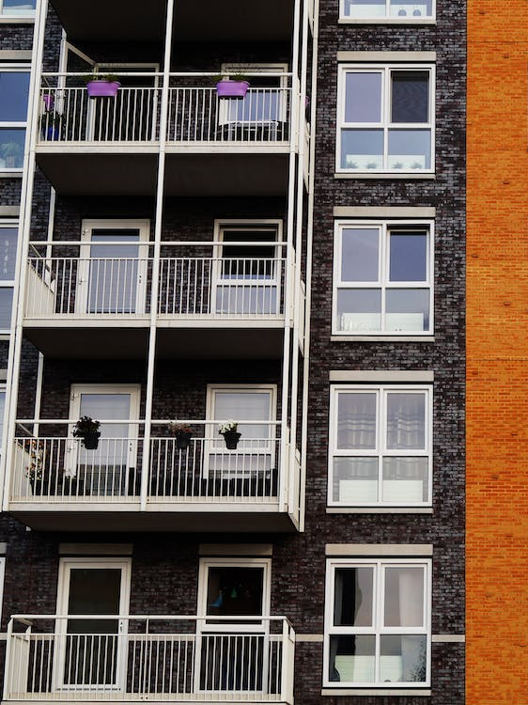
310 ILCS 10/8.10a
Effective 3/23/21
All Illinois PHAs are to collect and report annually to ICJIA
Disaggregated by the race, ethnicity, and sex of housing applicants

Slide 6
To Submit per the Act
number of applications submitted for admission to federally assisted housing.
number of applications submitted for admission to federally assisted housing of individuals with a criminal history record, if the authority is conducting criminal history records checks of applicants or other household members.
number of applications for admission to federally assisted housing that were denied on the basis of a criminal history record, if the authority is conducting criminal history records checks of applicants or other household members.
number of criminal records assessment hearings requested by applicants for housing who were denied federally assisted housing on the basis of a criminal history records check.
number of denials for federally assisted housing that were overturned after a criminal records assessment hearing.

Slide 7
Initial steps, before data collection
Talked to state experts
Reached out to PHAs
Asked about challenges to data collection, wording
Random selection of 9 PHAs
location (North, Central, South)
Housing authority type (city or county level)
Responses from four PHAs
2 central, city
2 southern, county

Slide 8
Data Collection Process
Online data collection tool
Emails to all housing authorities in April
Calls to clarify, check some data
Closed data collection May 2023

Slide 9
Who Reported in 2023?
74 IL PHAs
69% participation rate
City/county
56 county PHAs
18 city PHAs
Location
74 central
23 southern
18 northern
Urban/Rural
74 urban
28 rural

Slide 10
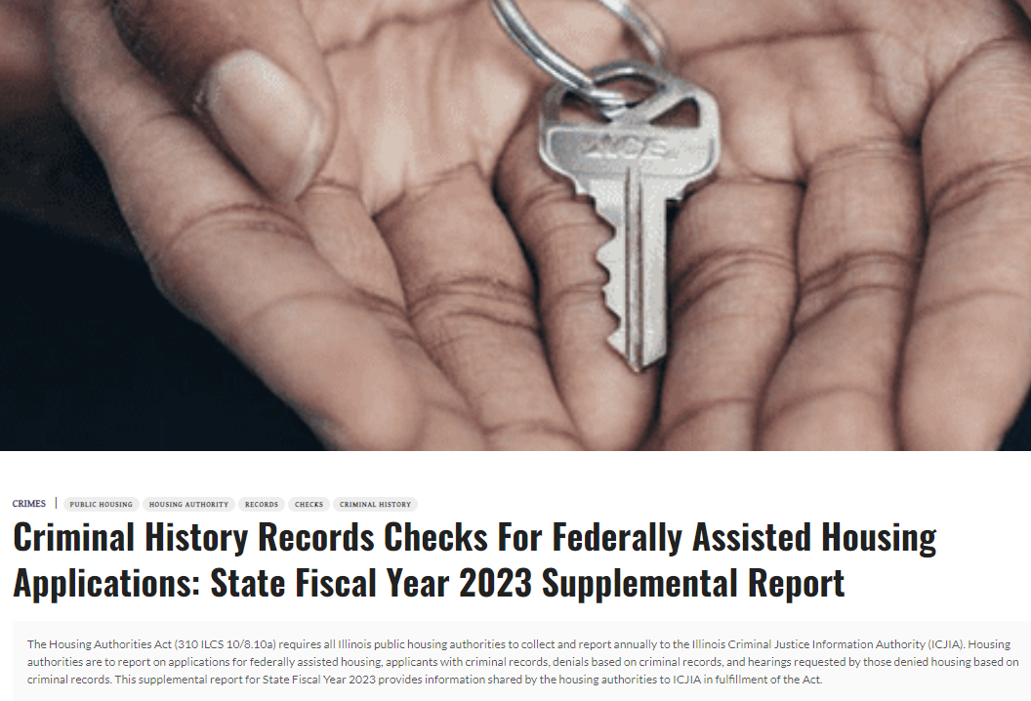
Notes:
Jan 2023 Progress report- our plans to collect data
March 2023 Annual report- what we had done so far with more detailed plans to collect the data

Slide 11
Applications with Criminal Records, Hearings (n = 74)

Slide 12
Missing Information
Not all PHAs reporting
A lot of unknown gender
19% of applications
71% of those denied
Unknown race
8.4% applications

Slide 13
Feedback from PHAs
Concerns raised
Cumbersome, burdensome, time consuming
Unfunded
Unavailable data, requires changes
Clarification needed
Issues regarding waiting lists
Definition of criminal history
Issues reported
Categories for denial (e.g., drug, sex offender)
Demographics not collected, not reported by applicants
Notes:
Bad checks, traffice

Slide 14
Changes to Legislation SB 1367
Public Act 103-0215
Effective date Jan 1, 2024
(b) Every Authority organized under the provisions of this Act shall collect the following data:
(1) the number of vacant rental units within each housing project operated by the Authority;
(2) information on whether each waiting list maintained by the Authority is open or closed.
Notes:
Governor approved 6/30/23

Slide 15
Next Data Collection Process
About Feb 2024 send email to collect data, PHAs reporting on CY2023 information
Online data collection tool open for month
We prepare report, internal review process
Publish end SFY24, by June 30, 2024
Legal Dept shares with Governor’s Office, Lt. Governor’s Office
We share with PHAs

Slide 16
Discussion
What are your thoughts on:
Participation by housing authorities?
Data collection process?
New data elements?

Slide 17
References
310 ILCS 10/8.10 https://www.ilga.gov/legislation/ilcs/fulltext.asp?DocName=031000100K8.10a
Bala, N., & Vallas, R. (2020, March 2). State momentum in criminal record sealing fuels federal Clean Slate Bill. The Hill. https://thehill.com/opinion/criminal-justice/485477-state-momentum-in-criminal-record-sealing-fuels-federal-clean-slate-bill/
Crowell, H. (2017). A home of one’s own: The fight against illegal housing discrimination based on criminal convictions, and those who are still left behind. Texas Law Review, 95. 1103-1143
Maranville, R., Reichert, J., Ott Hill, E., & Green, E. (2023). Criminal history record checks for federally assisted housing applications: State Fiscal Year 2023 supplemental report. Illinois Criminal Justice Information Authority. https://icjia.illinois.gov/researchhub/articles/criminal-history-records-check-for-federally-assisted-housing-applications--state-fiscal-year-2023-annual-report/
McCain, D. L., (2022). Implementation of the Office of General Counsel’s Guidance on Application of Fair Housing Act Standards to the use of criminal records by providers of housing and real estate-related transactions. U.S. Department of Housing and Urban Development. https://www.hud.gov/sites/dfiles/FHEO/documents/Implementation of OGC Guidance on Application of FHA Standards to the Use of Criminal Records - June 10 2022.pdf ↩︎
Public Act 103-0215 https://www.ilga.gov/legislation/publicacts/fulltext.asp?Name=103-0215

Slide 18
Contact Information
Jessica Reichert
Manager, Center for Justice Research & Evaluation
Illinois Criminal Justice Information Authority
Jessica.Reichert@Illinois.gov

