Slide 1
Advancing Renewable Energy in Affordable Housing
Kevin S. Hall
Assistant Director, Design, Construction & Regulatory Compliance
IL NAHRO 2023 Annual Conference
August 10, 2023

Slide 2
AGENDA
SUSTAINABILITY: Policy Priority
SUSTAINABILITY: Requirements
SUSTAINABILITY: Incentives
PROJECTS
INFLATION REDUCTION ACT: Incentives
Q & A

Slide 3
SUSTAINABILITY: Policy Priority
Improving housing quality through highly efficient building materials, housing sites that are integrated within community fabric, and reducing utility costs are tenant-focused initiatives that can, over the long-term, contribute to resident wellbeing.
QAP-related strategies supporting this focus area include:
Incentivizing high-quality, sustainable housing that integrate clean/non-toxic building materials; and
Prioritizing developments that go above the minimum requirements when it comes to energy efficiency and overall building quality.
Blue Green Alliance’s Scorecard on QAPs: How States Can Integrate Health, Energy Efficiency, Working Conditions, and Racial Equity into Qualified Allocation Plans
https://www.buildingclean.org/qap-report

Slide 4
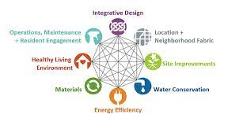
SUSTAINABILITY: Requirements
All Projects must adhere to Enterprise Green Communities 40 mandatory criteria as outlined within the following 8 categories:
Integrative Design
Location and Neighborhood Fabric
Site Improvement
Water
Operating Energy
Materials
Healthy Living Environment
Operations, Maintenance, and Resident Engagement

Slide 5
SUSTAINABILITY: Incentives
Green Building Certification | Basic Level (7 points) | Advanced Level (10 points) | Net Zero Energy Level (13 points)
Enterprise Green Communities (EGC) | Certification | Certification Plus | Certification Plus via Criterion 5.4
United States Green Building Council (USGBC) Leadership in Energy & Environmental Design (LEED) | Gold | Platinum | LEED Zero
International Living Future Institute (ILFI) | Core Green Building Certification | Living Building Challenge | Zero Energy Certification or Zero Carbon Certification
National Green Building Standard (NGBS) | Gold | Emerald | Green + Net Zero Energy
Passive House Institute US (PHIUS) | NA | Core | Zero
US Environmental Protection Agency(EPA)/US Department of Energy (DOE) | Energy Star | Zero Energy Ready Home (ZERH) | Zero Energy Ready Home (ZERH) + Solar

Slide 6
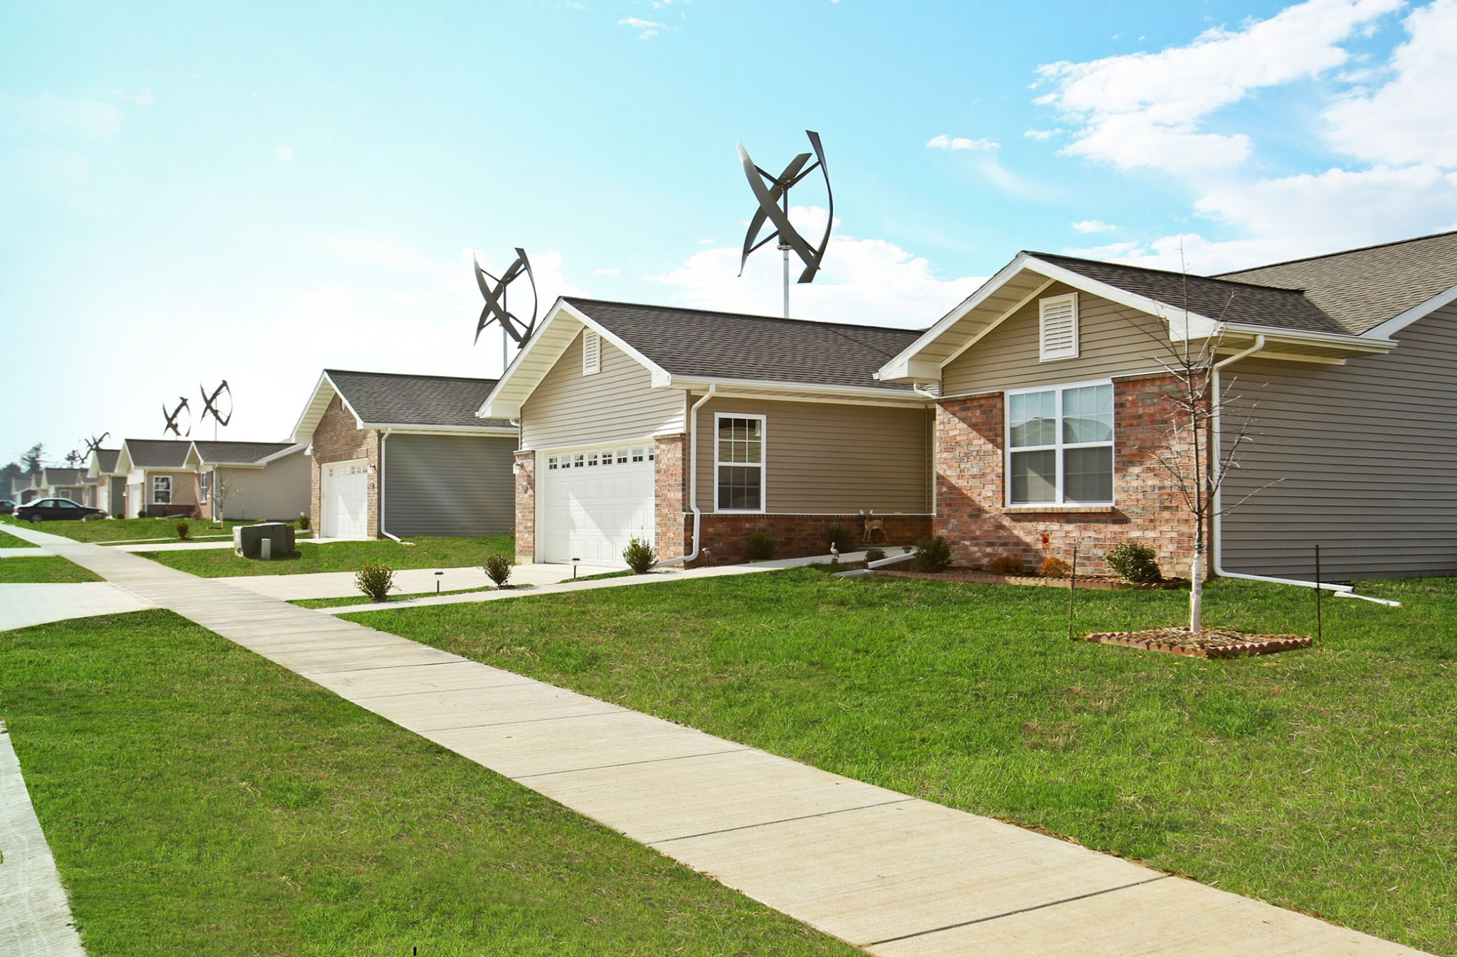
PROJECT 1: Lexington Farms, Jerseyville
Team
Developer: Capstone Development
Architect: Webster Design
General Contractor: Morrisey Construction
Scope: New construction of 32 single-family homes.
IHDA Resource: 2008 9% LIHTC, Section 1602 TCAP
Construction Cost: $5.9M
Green Building Certification: USGBC LEED Platinum
Renewable Energy: Solar panels and wind turbines

Slide 7
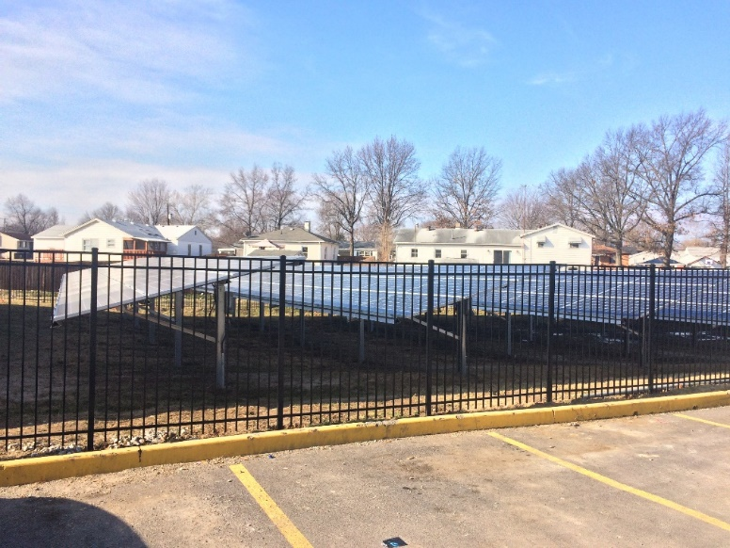
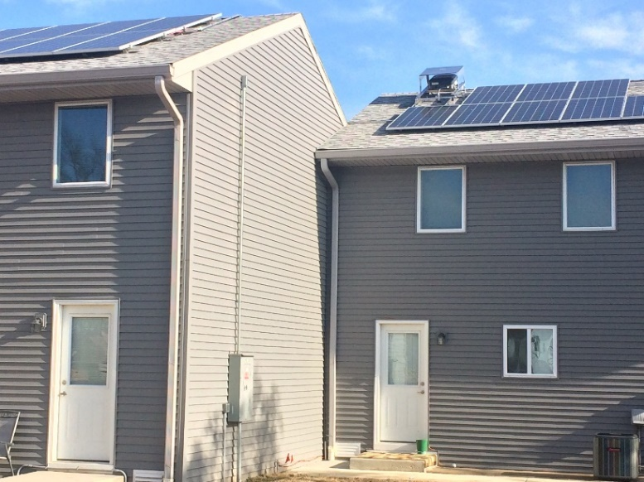
PROJECT 2: Township Village Apartments, East Alton
Team
Developer: Affordable Housing Continuum
Architect: Randall Bees Architectural Design
General Contractor: La Mancha Construction
Scope: Rehabilitation of one 98-unit, 9-story building and two 6-unit townhomes
IHDA Resources: IAHTF, IAHTC, Conduit Bond
Construction Cost: $6.1M
Green Building Certification: NA Renewable Energy: Solar panels

Slide 8
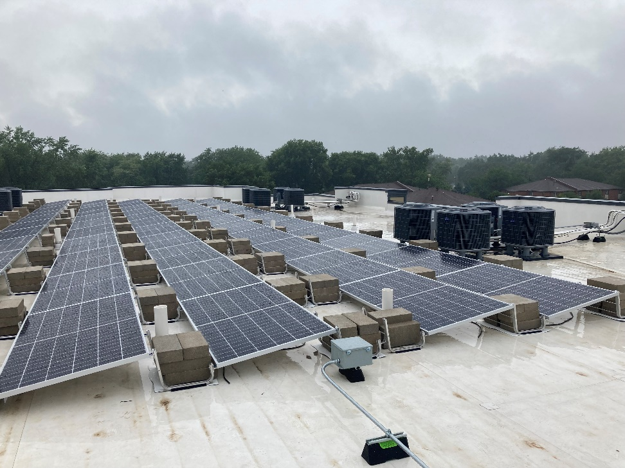
PROJECT 3: Lincoln Lofts, Bloomington
Team
Developer: St. Mary Development
Architect: North Arrow
General Contractor: North Arrow
Scope: New construction of 56-unit, 4-story building.
IHDA Resource: 2019 9% LIHTC, HOME, First Mortgage
Construction Cost: $12.1M
Green Building Certification: EGC
Renewable Energy: Solar panels

Slide 9
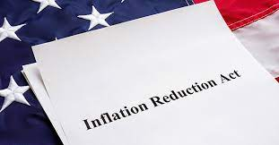
INFLATION REDUCTION ACT: Incentives
Section 25C: Nonbusiness Energy Property Tax Credit
Eligibility: Existing Buildings
Covers
Exterior Windows and Skylights: $600
Heat Pump; Heat Pump Water Heaters: $2,000
Maximum Annual Credit: $3200

Slide 10
INFLATION REDUCTION ACT: Incentives
Section 25D: Clean Energy Tax Credit
Eligibility: Existing & Newly Constructed Buildings
Covers
Solar Electric
Solar Water Heating
Fuel Cell
Small Wind Energy
Geothermal Heat Pump
Battery Storage Technology
Maximum Annual Credit
30%: 12/31/2021 - 01/01/2033
26%: 12/31/2032 - 01/01/2034
22%: 12/31/2033 - 01/01/2035

Slide 11
INFLATION REDUCTION ACT: Incentives
Section 30C: EV Charging Stations Tax Credit
Eligibility: Based on geographic restrictions as follows:
Low Income or High Poverty Census Tract (under New Markets Tax Credit criteria).
Non-Urban Area (as defined by U.S. Census Bureau).
Covers: Electrical Vehicle Charging Stations (placed in service).
Maximum Annual Credit: 6% of the cost, up to 30%, if project is compliant with prevailing wage requirements. Up to $100,000 for each charging station or refueling pump installed at a property. Stackable with LIHTC.

Slide 12
INFLATION REDUCTION ACT: Incentives
Section 45L: New Energy Efficient Home Tax Credit
Eligibility: Multifamily Housing, Newly Constructed Buildings (through 12.31.32).
Covers
Energy Star Certification
Zero Energy Ready Home (ZERH) Certification
Maximum Annual Credit (based on compliance with prevailing wage). Stackable with LIHTC.
Energy Star Certification: $2500
Zero Energy Ready Home (ZERH) Certification: $5000

Slide 13
INFLATION REDUCTION ACT: Incentives
Section 48: Investment Tax Credit
Eligibility: Existing & Newly Constructed Buildings.
Covers
Solar to generate electricity for heating or cooling.
Fiber-optic solar to illuminate the inside of a structure.
"Small wind" and microturbines.
Geothermal to produce electricity.
Geothermal heat pumps to heat or cool a structure.
Fuel cells.
Waste recovery.
Combined heat and power.
Energy storage (including thermal energy storage).
Dynamic glass.
Microgrid controllers.
Biogas property.
Linear generators.
Maximum Annual Credit: 6% of the cost, up to 30%, if project is compliant with prevailing wage requirements. Stackable with LIHTC.

Slide 14
INFLATION REDUCTION ACT: Incentives
Sources
Pursuing Green Projects: How Multifamily Affordable Housing Can Benefit from the IRA and BIL (National Housing & Rehabilitation Association, 02.23)
https://www.icastusa.org/pursuing-green-projects-how-multifamily-affordable-housing-can-benefit-from-the-ira-and-bil/
NGBS Green
https://www.homeinnovation.com/about/blog/20221129-mf-inflation-reduction-act?p=1&
Real Estate Roundtable
https://www.rer.org/detail/2022/08/09/rw-ira--climate-energy

Slide 15
Q & A

