Slide 1
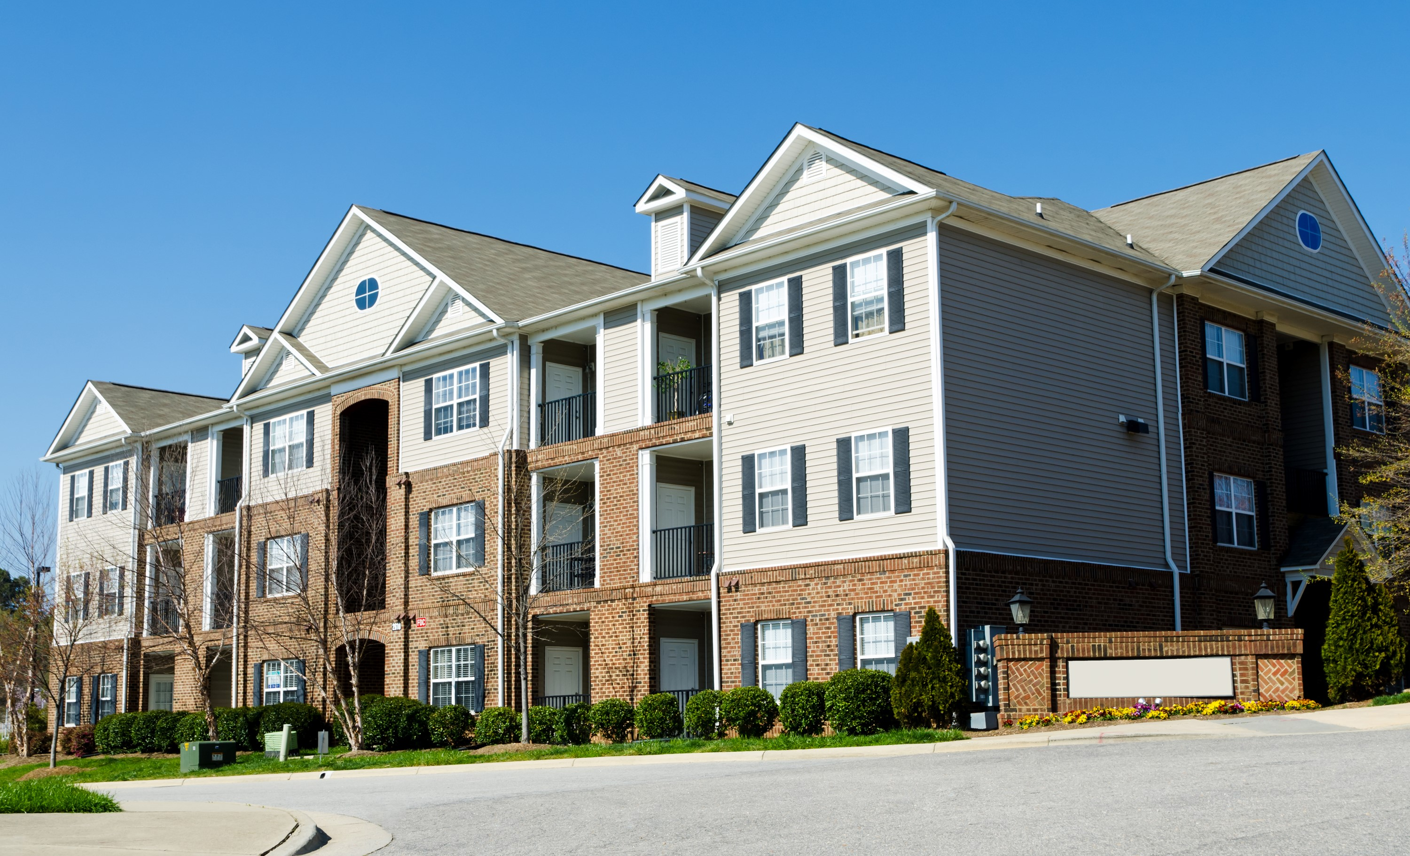
You Have the Power to Save:
Partnering with Your Utility to Lower Energy Costs

Slide 2
Why Energy Efficiency Upgrades?

Slide 3
Reduce Operating Expenses
Improve
Building
Longevity
Lower Maintenance Staff
Time
Energy
Efficiency
Benefits
Enhance Comfort & Healthy Environment
Lower
Turnover & Marketability
Increased
Safety
Notes:
Jen will speak to this – at the heart of Energy Efficiency Benefits….. One by one each of the hexagons

Slide 4
Expenses
High energy burdens for low-income households make up 25-45% of their monthly expenditures.*
Energy efficient buildings reduced overall energy usage in common areas and in tenant homes.
Reduced bottom line expenses for the property for overall utilities, including water.
Lowers energy expenses for tenants, aiding in sustainability.
Reduce
Operating
Expenses
*Source: American Council for an Energy-Efficient Economy

Slide 5
Maintenance
Replacing out of date equipment saves on service calls and repairs by property maintenance staff.
Air sealing and equipment retrofits reduce drafts and improve in-unit air quality, thus reducing calls from tenants for their units being too hot or too cold during temperature extremes.
Improving tenant comfort overall reduces calls to maintenance.
Lower
Maintenance Staff Time

Slide 6
Tenant and Staff Retention
Energy efficiency upgrades allow properties to stretch their operating budgets and plan better.
Better air quality and lower energy costs are a win-win for residents and properties, decreasing unit turnover.
Properties can highlight energy efficiency upgrades making properties more marketable.
Lower Turnover and
Marketability
Notes:
While we recognize that marketability may not be as important in Public Housing,

Slide 7
Common Areas
Brighter lighting in common areas and exterior spaces increases safety for residents and staff, deterring criminal activity.
Lower property liability for accidents in common spaces.
Improved lighting can transform how your residents feel, interact and live.
Increased
Safety

Slide 8
Comfort
Reducing drafts increases unit air quality, reduces pests and makes residents more comfortable creating a healthier home for residents.
Improves resident comfort by reducing temperature fluctuations that can occur when units are under-insulated.
Buildings with poor insulation and air sealing levels can cause heating and cooling systems to work overtime to maintain an even temperature.
Increased
Safety
Enhance Comfort & Healthy Environment

Slide 9
Equipment
Increased
Safety
Replacing outdated equipment assists with other mechanicals lasting longer by reducing the load.
Well sealed buildings have lower levels of moisture and last longer.
Lowers overall annual expenses to the property and to residents.
Improve
Building
Longevity

Slide 10
Healthy Buildings

Slide 11
Why Should We Create Healthier Buildings?
Health-related outcomes after energy efficiency upgrades include:
Improved general health.
Reductions in some asthma symptoms.
Fewer cases of hypertension and upper respiratory risks.
Enhanced energy efficiency upgrades have been shown to reduce indoor air contaminants linked to chronic illnesses, control environmental contaminants (dust mites, mold/moisture) that can trigger respiratory symptoms and improve symptoms of asthma and other respiratory health conditions.
Studies have also found reductions in other indoor air pollutants and reported improvements in blood pressure and fatigue.
Reduction in healthcare costs among U.S. residents.
Source: US Department of Energy

Slide 12
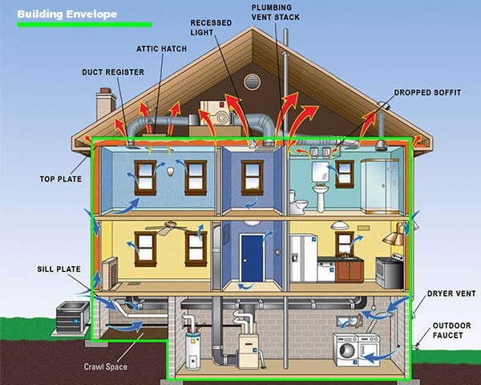
Do Your Tenants Complain About Drafts Inside Their Home?
Source: Energy.gov

Slide 13
What is a One Stop Shop Energy Assessment?

Slide 14
What is a One Stop Shop Assessment?
Whole property approach.
Buildings: look for ways to reduce heat/cooling load and loss.
Attic
Windows and doors
Equipment
Tenant units: identify ways to improve unit health, comfort and efficiency
Common areas:
Hallways, stairwells and common spaces.
Parking lot, streetlights and exterior lighting.

Slide 15
The Energy Assessment: What does it look like?
Energy Assessment completed for each property location.
Phone interview to gather information: having a subject matter expert about the demographics of the property is helpful
Review all the details of your resident buildings, units and common areas.
Review the types of equipment for heating and cooling, water heating and appliances.
Any construction or renovation plans.
Discuss any exterior spaces or structures.
Your Energy Advisor will create an Assessment Summary and discuss the findings with you regarding incentives and opportunities for increasing the energy efficiency of the buildings.
We will schedule an on-site walk through to assess the insulation levels and to use a thermal camera to look at wall, doors and windows for air leaks.
They will also walk around the exterior of the property to look for opportunities.
An Assessment Summary is created to highlight the ways your property can save energy.
Energy Advisor will work with you to select projects, coordinate Program Allies and be the central point of contact for planning and projects with your team.

Slide 16
What Does the Program Offer?
Provides certified energy efficiency experts to partner with your properties long term planning.
FREE Energy Assessments at each property to identify and coordinate energy efficiency projects with you.
Can highlight potential savings and assist with long-term goals.
Energy Advisors are building professionals certified to show you exactly why and where you are losing energy.
Program Staff is available to partner with your staff to educate residents for long term sustainability of energy efficiency gains.

Slide 17
Types Of Qualifying Properties
Public Housing Authority owned or managed properties.
Low income and not for profit organizations serving low-income residents.
Commercial and residential multifamily properties.
Shelters and emergency housing facilities.
Senior, veteran and disabled housing.
Mixed use buildings and condos.
Notes:
Describe what a mixed use building is

Slide 18
Home Efficiency Income Qualified Initiative
Notes:
The home efficiency income qualified initiative provides energy efficient upgrades to Single family homes with a household income of up to 300% of Federal Poverty Level or 80% of Area Median Income (AMI).

Slide 19
Home Efficiency Income Qualified (HEIQ) Initiative
Identify ways to bring a home’s efficiency up to its highest potential and reduce energy costs.
Eligible customers can receive a FREE Energy Assessment.
Energy Assessment also includes the direct install of energy saving measures including:
LED bulbs
Faucet aerators
High efficiency showerheads
An overall Energy Assessment of the home’s existing conditions is also provided to the customer to determine if the home qualifies for insulation and heating upgrades.
There is no charge for the Home Energy Assessment or for the products and services provided.
Notes:
After a customer is determined eligible a free home energy assessment audit

Slide 20
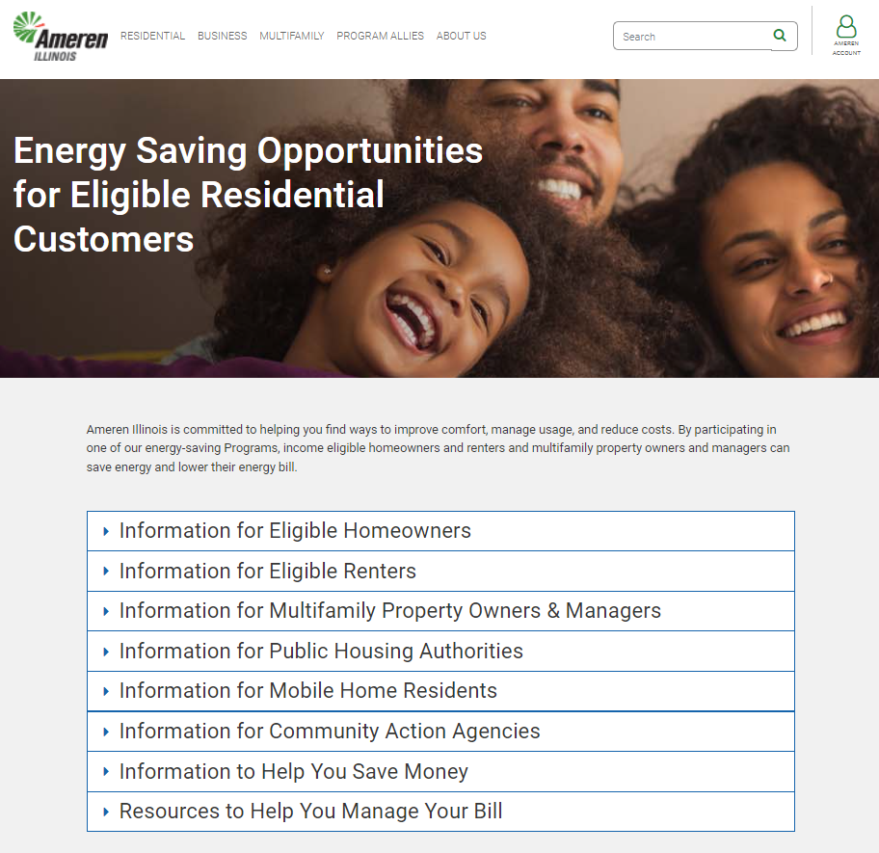
For more information on Initiatives available for income eligible customers, visit AmerenIllinoisSavings.com/Eligible.

Slide 21
Thank you!

